Slide 1
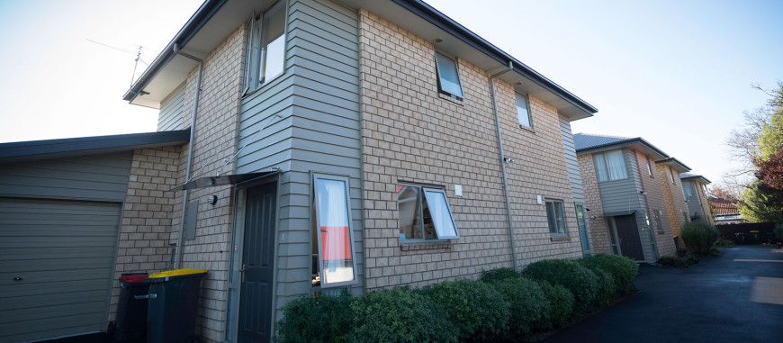
"Ko te whakaora, he hīkoi whakāmarama. Māna anō tōna ake ara whakaora e whakarau"
"A journey of discovery where an individual leads their own unique process of moving forwards"

Slide 2
Number of Surveys
136 surveys were posted out to tenants in late July 2021 and we received 42 back- of these 33 were named
Did Not Respond | 113
Respond | 35
148 surveys were posted out to tenants in late July 2022
and we received 35 back and these 2 were not named.

Slide 3
Number of Responses
by type of Property
COP1 - Comcare owned 1 tenant (excluding 2/288A Westminster Street for CIS) | 22
COP2 - Comcare owned multiple tenants (Group Living) | 5
CGH1 - Community Group Living 1 tenant | 1
CGH2 - Community Group Living Multiple tenants (Group Living) | 2
COPG - Comcare owned, 1 tenant (Group Living) | 1
No named – couldn’t identify property | 2
* CCH stock percentages: Not including Housing First.

Slide 4
Service from Tenancy Management
Overall how do you find the service offered to
you by your Tenancy Manager?
Very good | 23
Good | 14
Average | 1
Poor | 3
Grand Total | 41
Very good | 22
Good | 12
Average | 1
Grand Total | 35
90% of the responses were good and very good.
97% of the responses to this question were either very good or good.
Comment : “The service is outstanding and grateful appreciate”

Slide 5
Service from Tenancy Management
If you need to contact your Tenancy Manager,
how easy is this to do?
Very good | 17
Good | 13
Average | 2
Poor | 1
Very Poor | 1
Grand Total | 34
Very good | 17
Good | 14
Average | 5
Poor | 2
Grand Total | 38
81% of the responses were good and very good.
88% of the responses to this question were either very good or good.
Of the 2 feedbacks, poor and very poor the tenants gave the reasons for this is they left voice messages and didn’t hear back in timely manner.
Comment : “My Tenancy Manager is very good at communicating and helpful at the time of need”

Slide 6
Service from Tenancy Management
How do you rate the advice and information
given to you regarding your tenancy rights and
responsibilities?
Very good | 17
Good | 14
Average | 5
Poor | 2
Grand Total | 38
Very good | 18
Good | 10
Average | 4
Poor | 1
Grand Total | 33
Of the 1 feedback poor did not provide the reason.
Most of comments from tenants were satisfied in the information given.

Slide 7
Service from Tenancy Management
If you have a maintenance problem at the property,
how do you rate the efficiency with which the
matter was dealt with by your Tenancy Manager?
Very good | 19
Good | 11
Average | 4
Poor | 2
Grand Total | 36
Very good | 21
Good | 12
Average | 2
Grand Total | 35
83% of the responses were good and very good.
94% of the responses to this question were either very good or good.
Comment : “Any concerns I have, my Tenancy Manager is always there to support and deal with it as much as possible”

Slide 8
Maintenance
If you have a maintenance problem at the
property, how do you rate the tradespeople
that attended to the matter?
Very good | 22
Good | 7
Average | 5
Poor | 2
Grand Total | 36
Very good | 22
Good | 9
Average | 3
Grand Total | 34
80% of the responses were good and very good.
91% of the responses to this question were either very good or good.
Comment : “All the trades people we have dealt with, they have been skilled and professional”

Slide 9
Maintenance
If you have any other issues, how do you
rate how the matter was dealt with?
Very good | 18
Good | 12
Average | 3
Poor | 2
Grand Total | 35
Very good | 16
Good | 7
Average | 4
Very Poor | 1
Grand Total | 28
83% of the responses were good and very good.
82% of the responses to this question were either very good or good.
Of the very poor feedback given the reason was it took too long to get the issue resolved.
Comment : “The matters were solved perfectly well”

Slide 10
Property - Interior
How do you rate the condition of the
interior of your property?
Very good | 24
Good | 13
Average | 1
Grand Total | 38
Very good | 22
Good | 9
Average | 4
Grand Total | 15
92% of the responses were good and very good.
89% of the responses to this question were either very good or good.
Comment : “Comcare have provided a very new interior”

Slide 11
Property - Exterior
How do you rate the condition of the
exterior of your property?
Very good | 18
Good | 12
Average | 1
Poor | 1
Very Poor | 1
Grand Total | 33
Very good | 22
Good | 13
Average | 5
Grand Total | 40
87% of the responses were good and very good.
91% of the responses to this question were either very good or good.
One very poor complained about driveway that flooded every time it rained. The problem has now been resolved.

Slide 12
Property - Safety
At your property / complex how do you rate the safety?
Very good | 19
Good | 15
Average | 6
Grand Total | 40
Very good | 21
Good | 9
Average | 4
Grand Total | 34
85% of the responses were good and very good.
88% of the responses to this question were either very good or good.
Comment : “Comcare are very aware and attentive of the safety of my home”

Slide 13
Property - Communal areas
At your property /complex how do you rate the
communal areas?
Very good | 23
Good | 11
Average | 2
Poor | 1
Grand Total | 37
Very good | 17
Good | 8
Average | 6
Very Poor | 1
Grand Total | 32
92% of the responses were good and very good.
78% of the responses to this question were either very good or good.
One of the very poor was same person who rated in Maintenance and Exterior questions, and the issues are now resolved.
Only one from the average gave the reason that only car park is applicable for tenants.
Comment : “Comcare provided a lovely new lounge suite a few years ago and the communal area is lovely”

Slide 14
Property - Relationships with neighbours
At your property / complex how do you rate your relationship with your neighbours?
Very good | 18
Good | 17
Average | 2
Poor | 2
Grand Total | 39
Very good | 14
Good | 11
Average | 8
Grand Total | 33
90% of the responses were good and very good.
76% of the responses to this question were either very good or good.
Comment : “We have lovely neighbours. A very nice family indeed”
“We have a good little community vibe in our complex and look out for one another”

Slide 15
Tenant Welfare Service
If you have used this service or are currently using it,
could you please let us know of your experience?
Very good | 7
Average | 2
Very Poor | 1
Grand Total | 10
70% of the responses to this question were very good.
There are 20 tenants that didn’t rate the question from 35 responds.
The very poor gave the reason why is that they didn’t know that the role existed – we have published this new role in the tabloid a few times.

Slide 16
Tenant Welfare Service - Comment :
“As far as I know, we haven’t used it yet. Honestly said that Comcare has always been sensitive to and helpful regarding our welfare needs”
“I Haven’t used it, but I think it is a great idea”
“Haven’t used yet but know about the service”

Slide 17
Improvements - to Service :
“No improvement needed. I am sure you will keep up your highly professional caring and helpful service”
“More notice for house inspection”
“A bit of painting to house roof. I notice it was pealing”
“I can’t think of any. You are so wonderful and kind and looking after us well”

Slide 18
Improvements – Property/ Complex :
“Would love to have a proper front fence instead of trellis fencing. Everyone that parks outside my place looks straight into my yard and lounge”
“No, it is beautiful place in a very happy area”
“Suggests blinds for all the rooms and the alarm system needs repairing” – the alarm system has been fixed.

Slide 19
Any other suggestions or comments?
“Just so thankful to have a place that one can call home. Somewhere one can keep secure, clean, warm and content”
“Just a big thank you for all you have done regarding the home, cleaning, maintenance and renovation. You have been very professional caring and helpful to us. Keep up the good work”
“More help with connecting within the community as I find this hard especially in Christchurch”
“ Love you all”

